Slide 1


Fundamentals of RM
RM System and Process
Leadership in RM
Incident Investigation
RM Tools & Challenges
RM in Industry
People & Org.
Application and Perspectives
On Becoming a
Leader in Risk Management
ENGG404 - Lecture
Chapter 2.2:
Hazard Recognition and
The Energy Wheel

Slide 2
Learning Outcomes:
Explain the importance of hazard recognition.
Differentiate between a hazard, the severity of hazard, and consequences (impact on PEAP).
Differentiate Occupational Safety and Technical Safety:
Explain and apply The Energy Wheel for hazard recognition, and explain the role of energy sources in relation to incidents.
Chapter 2.2: Hazard Recognition and The Energy Wheel
2
Notes:
2

Slide 3
Importance of Hazard Recognition:
Inadequate hazard recognition is associated with about half of incidents
Too often dismissed as complacency during investigations
Hazards with low cognitive effort usually easily identified e.g. gravity, motion, sharp edges
Hazards with higher cognitive effort are often missed e.g. mechanical, pressure, chemical
It follows, then, that developing skills to recognize (and address) hazards will prevent incidents.
As we will see, The Energy Wheel is a key tool to improving hazard recognition.
Chapter 2.2: Hazard Recognition and The Energy Wheel
3
Notes:
3

Slide 4
Activity, Hazards, Consequences, and Loss Incident:
An activity describes a situation where things are being done. Activities are often associated with hazards. An activity can describe:
A task or job being performed by a person.
  Examples: ascending a ladder, operating a crane, driving a truck.
Operations at an industrial facility.
  Examples: a tank used for storing materials; a mine; a drilling rig; a rail-car loading facility.
Hazards are “things” that can do harm(often associated with energy), and help inform us about “What can go wrong”
Consequence is “How bad it can be” if something goes wrong (described as the negative impacts on PEAP, or losses)
A Loss Incident is an unplanned, undesired event that resulted in a loss.
Chapter 2.2: Hazard Recognition and The Energy Wheel
4
Notes:
4
Incident versus accident – make the distinction here

Slide 5
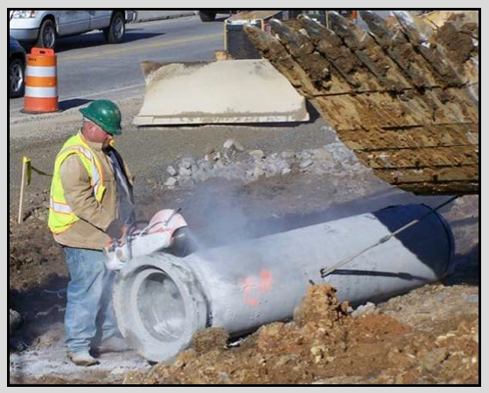
ALE #1: An Activity, its Hazards, and Consequences:
Please confer (MM not intended):
Activity: The worker is using a concrete saw to cut the bell off the pipe.
Q: What are some hazards? Some consequences?
Chapter 2.2: Hazard Recognition and The Energy Wheel
5
Notes:
5

Slide 6
Differentiate Hazards and Consequences:
Consider the hazards that you managed in your work experiences.
Were these exclusively occupational, or something else?
Most hazards are seen as occupational safety issues.
Workers successfully manage their exposures on a daily basis.
When they don’t, they may be injured i.e. a consequence.
Corrosive Substance | Toxicity | Inert Gas | Oxygen Deficiency
Radiation | Moving Equipment / Machinery | Cryogenic Temperature | High Pressure
Vibration | Unstable Materials | High Temperature | Slippery Surfaces
Flammability | Noise | Combustible Dust | Elevations
High Voltage | Vacuum | Pressure Cycling | Liquefied Gases
Context is important. Consider corrosion: it is can be a hazard and a consequence e.g. steel-work is degraded from exposure to acid gases (consequence); steel-work could collapse (hazard).
Chapter 2.2: Hazard Recognition and The Energy Wheel
6
Notes:
6
It can be both – a hazard ie corrosive substance in a pipe or a consequence ie corrosion of rebar due to water penetration

Slide 7
We Use Our Knowledge & Experience to Identify Hazards:
When examining the concrete cutting job, we used our knowledge!
Hazards can be identified based on knowledge of the person looking for the hazards (inspector) and/or documented.
BUT … what if we do not possess that knowledge?
We can ask others who have different expertise.
OR
We can analyse it i.e. higher cognitive effort.
Apply The Energy Wheel to support that effort.
Chapter 2.2: Hazard Recognition and The Energy Wheel
7
Notes:
7

Slide 8
Energy Theory:
The Haddon Energy Theory:
Based on observation that all injuries are the result of some undesirable contact between a person and one or more energy sources
Per this theory, a hazard is a source of energy that sound cause injury, illness, or death
Conceptualize hazards according to the type of energy they represent (e.g. gravity, motion, mechanical, electrical, pressure)
The Energy Wheel – a simple set to search for hazards
Chapter 2.2: Hazard Recognition and The Energy Wheel
8
Notes:
8

Slide 9
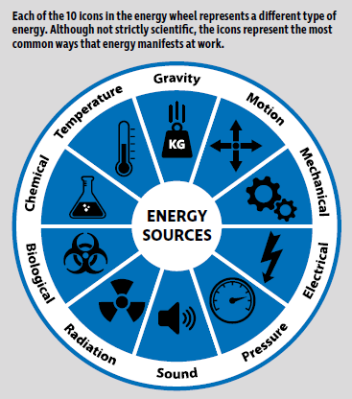
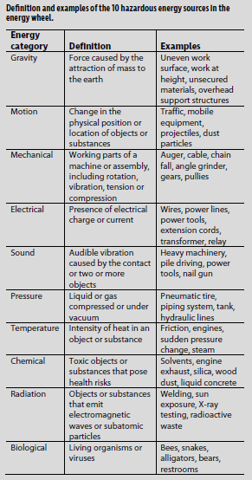
The Energy Wheel:
Chapter 2.2: Hazard Recognition and The Energy Wheel
9
Notes:
9

Slide 10
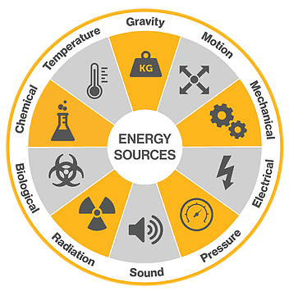
ALE #2: Apply the Energy Wheel – Occupational Safety
Please confer:
Q: What are the energy sources?
Chapter 2.2: Hazard Recognition and The Energy Wheel
10
Notes:
10

Slide 11
Example: Apply the Energy Wheel
Energy Sources:
Rolling pipe (motion)
Dust, flying debris (motion)
Traffic (motion)
Uneven surface (gravity)
Excavator bucket (motion)
Dozer (motion)
Cable tension (mechanical)
Rotating saw blade (mechanical)
Kick-back (motion)
Hot saw blade (temperature)
Cutting Saw (sound)
Chapter 2.2: Hazard Recognition and The Energy Wheel
11
Notes:
11

Slide 12
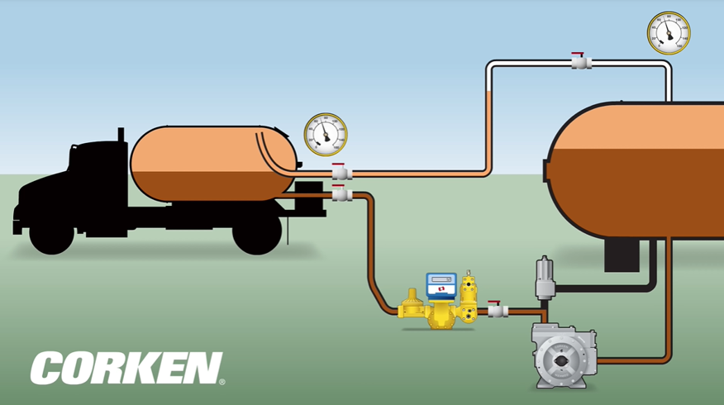
Differentiate Occupational Safety and Technical Safety:
Loss incidents include two broad categories:
Occupational (Workplace): worker injuries, such as cuts, trips, slips, and falls, or generically “struck by”, “struck against”.
Technical Safety: loss of control or an unintentional release of some form of energy.
Sub-sets: Chemical Process Safety (Sunrise Propane), structural collapses, regional black-outs …
Chapter 2.2: Hazard Recognition and The Energy Wheel
12
Notes:
12

Slide 13
ALE #3: Apply the Energy Wheel – Technical Safety
Thinking back to Sunrise Propane and this tank-to-truck loading operation, please confer on this question:
Q: What are the energy sources?
Chapter 2.2: Hazard Recognition and The Energy Wheel
13
Notes:
13

Slide 14
Summary and Key Lessons:
All activities have associated hazards; uncontrolled hazards lead to consequences.
Hazard recognition is a key concept for preventing incidents.
Context is important where there is a need to differentiate between a hazard, severity of hazard, and a consequence
The Energy Wheel is:
A useful tool for improving hazard recognition, specifically the nature of the energy sources because it aids us in applying higher cognitive effort, and
It can be used for analyzing both occupational and technical safety.
Chapter 2.2: Hazard Recognition and The Energy Wheel
14
Notes:
14

Slide 15
Any questions?
Notes:
15

